Slide 1
Changelog
2016-12-01 | Created | Chijiiuzo@
2018-02-14 | Updated to use new AWS branding and new PPT template. Cleanup of layout and pictures on some cluttered slides. Added a few slides from re:Invent 2017. | eromani@
2018-04-20 | Updated from https://tt.amazon.com/0147593454 | anupsiva@
2019-01-15 | Update Database portfolio + logos | xraffin@

Slide 2
Databases on AWS
Ricardo Peters, ricapete@amazon.com
Brian Fanning, bfannin@amazon.com
May 8th 2019

Slide 3
Agenda
AWS Database Services
Traditional vs AWS Data services model
Amazon RDS
Redshift
DynamoDB
ElastiCache
Neptune

Slide 4
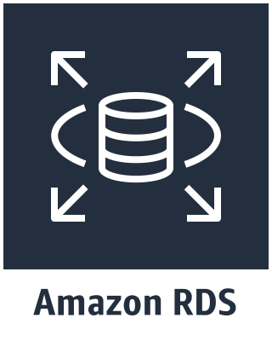
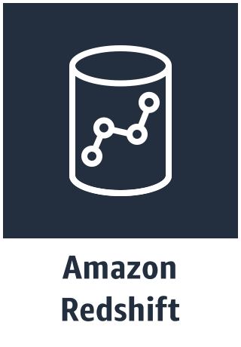
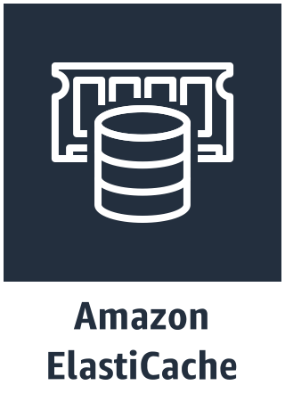
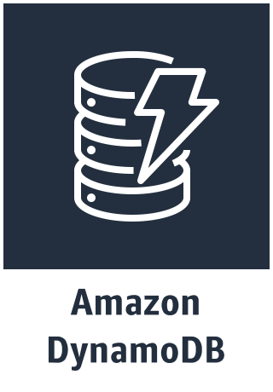
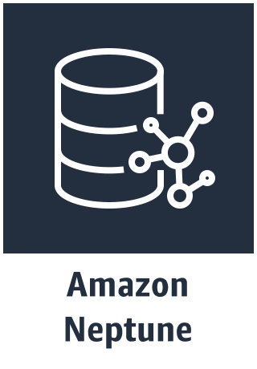


AWS Database Services
Managed Relational
Database Service
Petabyte-scale
Data Warehouse
Service
In-Memory key Value Store Service
(Preview)
NoSQL Key Value
Oriented Service
NoSQL Graph Oriented Service
NoSQL Document Oriented Service
Mongo Compatible
Amazon
DocumentDB
(Preview)
(Preview)
Time Series Database Service
Quantum Ledger Database Service
Amazon
Timestream
Amazon
QLDB

Slide 5
Traditional Database Architecture
Client Tier
one database for all workloads
App/Web Tier
RDBMS

Slide 6
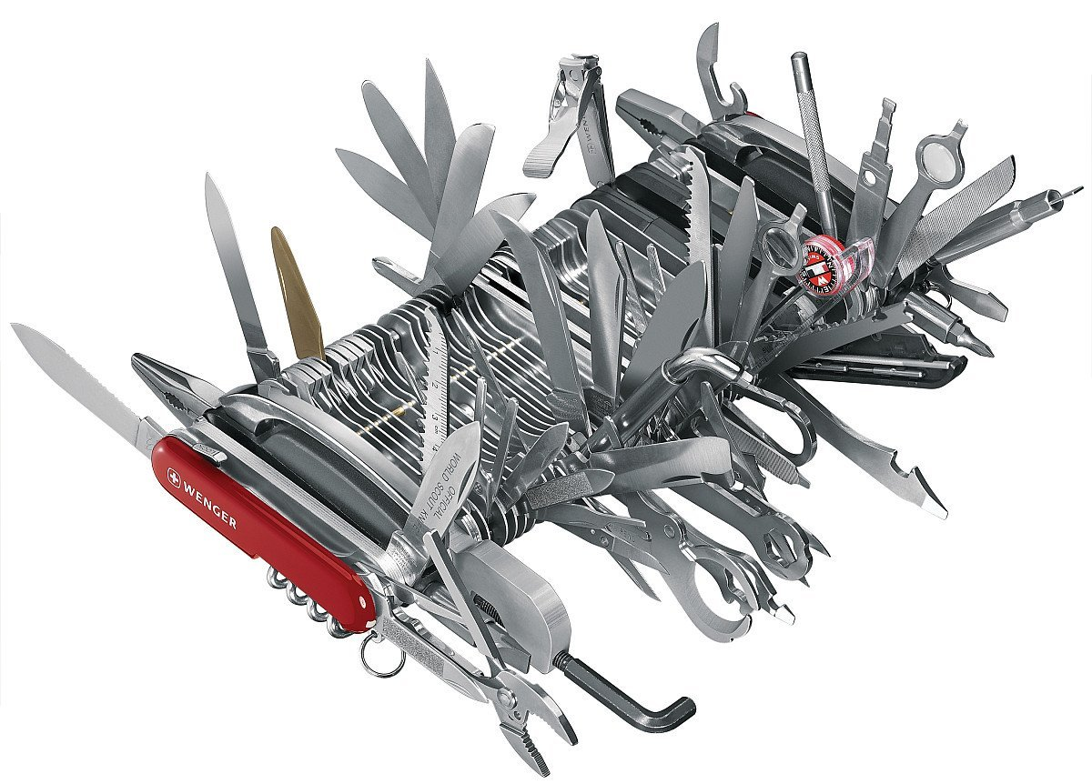
Traditional Database Architecture
Key-value access
Complex queries
OLAP transactions
Analytics
Client Tier
App/Web Tier
RDBMS
All forced into the relational database

Slide 7
AWS Data Tier Architecture
Client Tier
On AWS choose best database service for each workload
App/Web Tier
Data Tier
Cache
Data Warehouse
Time Series
Blob Store
NoSQL
RDBMS
Quantum Ledger
Search

Slide 8
Workload Driven Data Store Selection
hot reads
analytics
logging
NoSQL
simple query
Graph / Key Value / Document
complex queries
& transactions
Periodic
data
rich search
Untampered
data
Data Tier
Cache
Data Warehouse
Time Series
Blob Store
NoSQL
RDBMS
Quantum Ledger
Search

Slide 9
AWS Database Services for the Data Tier
hot reads
analytics
logging
NoSQL
simple query
Graph / Key Value / Document
complex queries
& transactions
Periodic
data
rich search
Untampered
data
Data Tier
Amazon
ElastiCache
Amazon
Redshift
Amazon
Timestream
Amazon S3
Amazon DynamoDB
Neptune / DocumentDB
Amazon
RDS
Amazon
QLDB
Amazon
ElasticSearch

Slide 10





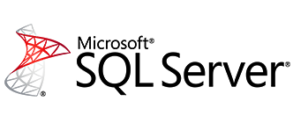
Relational Databases
Amazon Aurora, MySQL, PostgreSQL, Oracle, SQL Server, MariaDB
Fully managed; zero admin

Slide 11


If you host your databases on-premises
App optimization
Scaling
High availability
Database backups
DB s/w patches
DB s/w installs
OS patches
OS installation
Server maintenance
Rack & stack
Power, HVAC, net
you

Slide 12
If you host your databases in Amazon EC2
App optimization
Scaling
High availability
Database backups
DB s/w patches
DB s/w installs
OS patches
OS installation
OS installation
Server maintenance
Server maintenance
Rack & stack
Rack & stack
Power, HVAC, net
Power, HVAC, net
you

Slide 13
If you choose Amazon RDS
App optimization
Scaling
Scaling
High availability
High availability
Database backups
Database backups
DB s/w patches
DB s/w patches
DB s/w installs
DB s/w installs
OS patches
OS patches
OS installation
OS installation
Server maintenance
Server maintenance
Rack & stack
Rack & stack
Power, HVAC, net
Power, HVAC, net
you

Slide 14

Key Amazon Amazon RDS Features
Multi-AZ
Amazon RDS Configuration | Improve Availability | Increase Throughput | Reduce Latency
Push-Button Scaling
Multi AZ
Read Replicas
Provisioned IOPS
availability zone
availability zone
Region
Push-Button Scaling
Read Replicas
Provisioned IOPS

Slide 15
Amazon RDS -- Aurora
Amazon Aurora is a MySQL-compatible relational database engine
Built from the ground up to leverage AWS
Speed and availability of high-end commercial databases
Simplicity and cost-effectiveness of open source databases
Retains compatibility with MySQL 5.6
Up to 5x better performance than MySQL
At a price point 1/10 of a commercial database
Data is transparently replicated 6 ways among 3 Availability Zones
Encryption at rest and in transit
Add up to 15 Replicas
Compatibility with PostgreSQL

Slide 16
(Preview)
Aurora Multi-Master
First relational DB service with scale-out reads and writes, across multiple datacenters
Scale out both reads and writes
Zero application downtime from ANY instance failure
Zero application downtime from ANY AZ failure
Faster write performance and higher scale
Sign up for single-region multi-master preview today; multi-region multi-master coming in 2019
Application
Read/Write Master 1
Read/Write Master 2
Read/Write Master 3
Shared distributed storage volume
Availability Zone 1
Availability Zone 2
Availability Zone 3

Slide 17
Aurora Serverless
On-demand, auto-scaling database for applications with variable workloads
Application
Starts up on demand, shuts down when not in use
Automatically scales with no instances to manage
Pay per second for the database capacity you use
Database Endpoint
Scalable Database Capacity (Compute + Memory)
Warm Capacity
Pool
Shared Distributed Storage

Slide 18

for as low as $934/TB per year
Petabyte scale
Massively parallel
Columnar Store Relational data warehouse Fully managed = no admin

Slide 19
Amazon Redshift
Fast and powerful, petabyte-scale data warehouse
Fully managed Relational Database
Highly-parallel
Columnar Data Store
Data warehouse-type queries
Aggregations, historical analysis
BI Tool integration
Grow with your data
160 GB → 1.6 PB
SSD and SAS Options
SSD provides 10-15x perf @ 5.5x the cost per TB/year

Slide 20
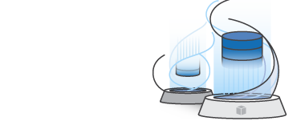
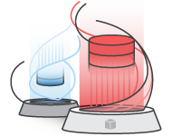
AWS DMS & AWS SCT
AWS Database Migration Service (DMS) easily and securely migrates and/or replicates your databases and data warehouses to AWS
AWS Schema Conversion Tool (SCT) converts your commercial database and data warehouse schemas to open-source engines, Amazon Aurora and Redshift. Converts and loads data warehouse data into Amazon Redshift
We have migrated over 103,000 unique databases. And counting…

Slide 21
NoSQL Database Seamless scalability Zero admin Single digit millisecond latency Multi-Master Multi-Region

Slide 22

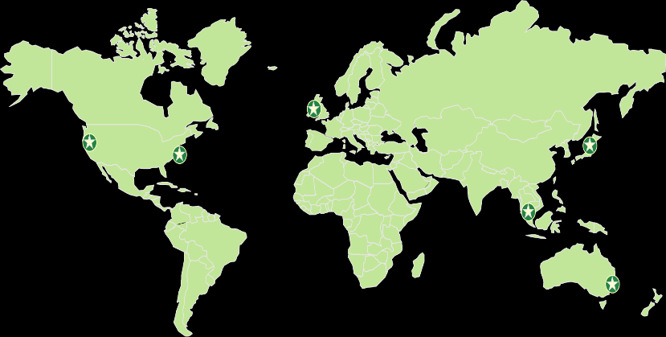


DynamoDB Global Tables First fully managed, multi-master, multi-region database
Globally dispersed users
Global App
Build high performance, globally distributed applications
Low latency reads & writes to locally available tables
Disaster proof with multi-region redundancy
Easy to setup and no application re-writes required
Replica (Europe)
Replica (N. America)
Replica (Asia)
Global Table

Slide 23
NoSQL vs. SQL for a new app: how to choose?
Want simplest possible DB management?
Want app to manage DB integrity?
Need joins, transactions, frequent table scans?
Want DB engine to manage DB integrity?
Team has SQL skills?

Slide 24
Amazon ElastiCache
In-memory cache in the cloud
Improve latency and throughput for read-heavy workloads
Supports open-source caching engines
Memcached
Redis
Fully managed
Multi-AZ
Examples
Caching of MySQL database query results
Caching of post-processing results
Caching of user session & frequently accessed data

Slide 25
Amazon Neptune Fully managed graph database for highly connected data
Open
Fast & Scalable
Reliable
Easy
Gremlin
SPARQL
Supports Apache TinkerPopTM & W3C RDF graph models
Store billions of relationships; query with millisecond latency
6 replicas of your data across 3 AZs with full backup and restore
Build powerful queries easily with Gremlin and SPARQL
+
GRAPHQL with AppSync
Notes:
Resource Description Framework(RDF)
World Wide Web Consortium (W3C)

Slide 26
It’s all about
choice
Performance-oriented
Cost-oriented

Slide 27

Any Questions?

